Slide 1
CSE4015 - HCI – REVIEW 1 SMART ACCESS CONTROL FOR RESIDENT WITH TRANSFER LEARNING AND EASYOCR
1
TEAM MEMBERS
SANJIL K C - 20BCE1855
DEVARINTI DHAPATLA PUNEETH REDDY - 20BCE1852
KARTHIC S - 20BCE1840

Slide 2

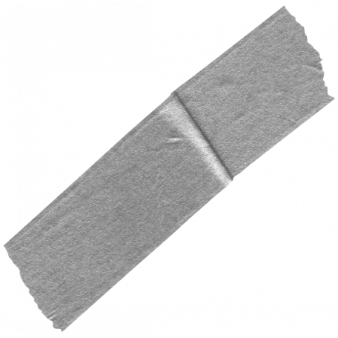
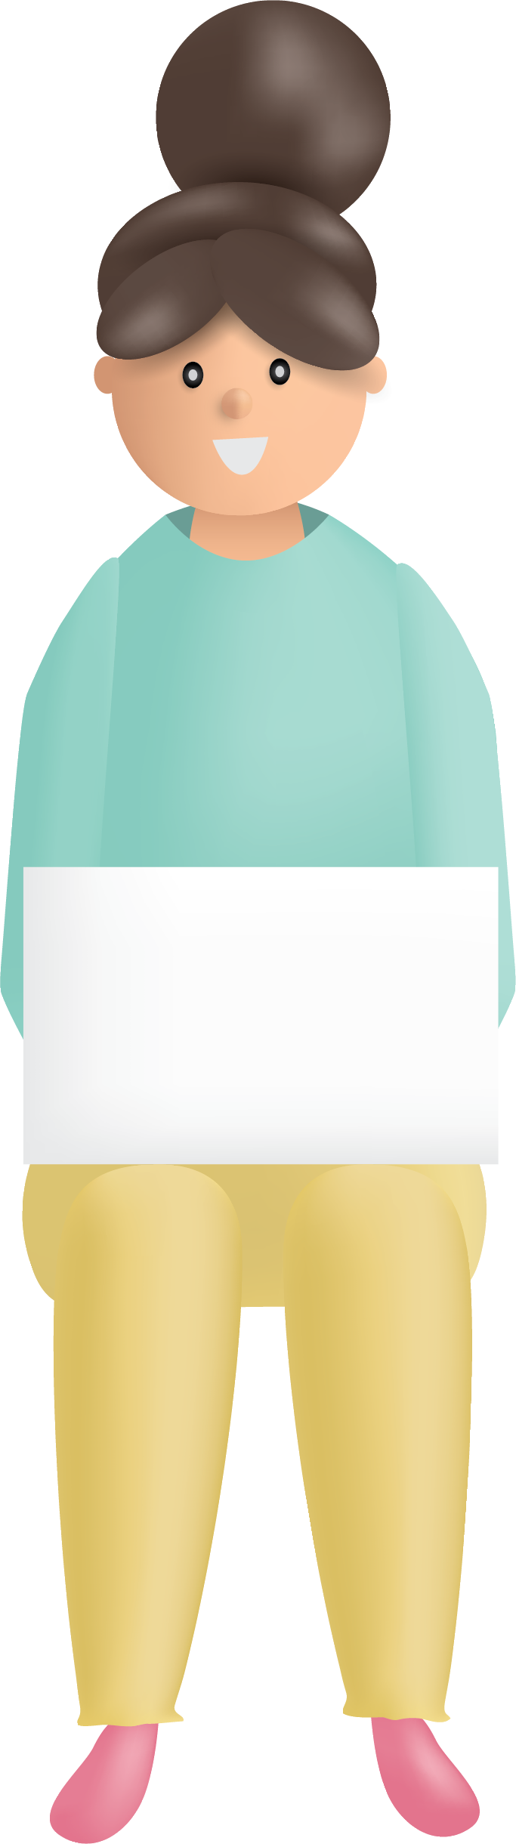


ABSTRACT
The number plate recognition is a computer system that automatically recognized digital images of number plates. The system includes various operations such as taking photos, locating the number plate, clipping characters, and OCRing the alphanumeric characters.
The main idea of ​​this system is to design and develop effective image processing techniques and algorithms to identify the number plate in the acquired image, separate the characters from this license plate, and extract each character of the segment. It is identified by using the Open Computer Vision Library. It is implemented with the K-NN algorithm and the Python programming language. This system can be used to implement many applications such as: Security, resident vehicle detection, highway speed detection, traffic light violations, handwritten text identification, stolen vehicle detection, automated toll collection systems, and more.

Slide 3
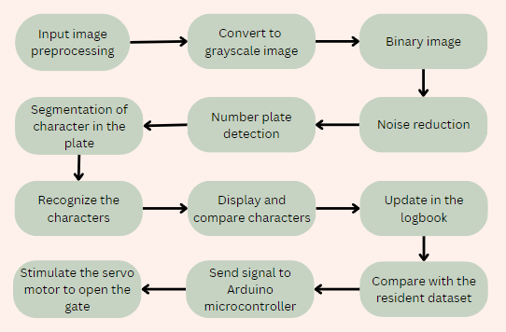
BLOCK DIAGRAM

Slide 4



MODULE 1 - DETECTION OF NUMBER PLATE
The car's number plate is taken from a high-resolution camera.
The license plate is extracted using either a shape analysis or a color analysis method.
Before finding the rectangle in an image, the image must be in a binary image or the edges of the image should be detected.
Finally, the areas connected to the box are connected and all rectangular areas of interest are extracted.
MODULE 2 – OPTICAL CHARACTER RECOGNITION
Once the license plate has been extracted, each character must be fragmented.
For component division, the component label is used to see the computer in order to discover the connected areas in binary digital images.
To identify characters, the segmented characters in the license panel must match the templates that are already created.
The recognition process returns the license number in ASCII format and saves it in a text document.
Each word is passed to the adaptive workbook as training data and learn the text more accurately.

Slide 5

MODULE 3 FACE RECOGNITION
Capture and Train Faces:
Create a dataset of face images for the individuals you want to recognize. Organize these images into separate folders for each person. Use OpenCV to capture face images using your laptop's camera. Save these images in their respective folders.
2. Integrate with Number Plate Recognition:
Capture frames from the camera, then use your face recognition model to identify faces.
3. Associate Faces with Number Plates:
Create a data structure or database that associates recognized faces with corresponding number plates.
4. Security and Access Control:
Implement security and access control logic based on the recognition results.
For instance, if a recognized face corresponds to an authorized user, grant access.

Slide 6
MODULE 4 AND MODULE 5
MODULE 4
LOG BOOK ENTRY
MODULE 5
HARDWARE IMPLEMENTATION
After the extraction of the characters from the number plate, the identified number is recorded in a csv file
Each plate checked with the existing resident data to verify the legitimacy and permit entry to the residents.
Here, we connect Python with the Arduino using pyFirmata.
With this we will be able to establish an interface by which Python can communicate with the Arudino Micro controlloer.
Then a servo motor is also connected with the Arduino which is simulated with the help of commands from Python.
This is then used to open the gate (Servo motor) if the vehicle belongs to the resident only.

Slide 7

THANK YOU

